Slide 1
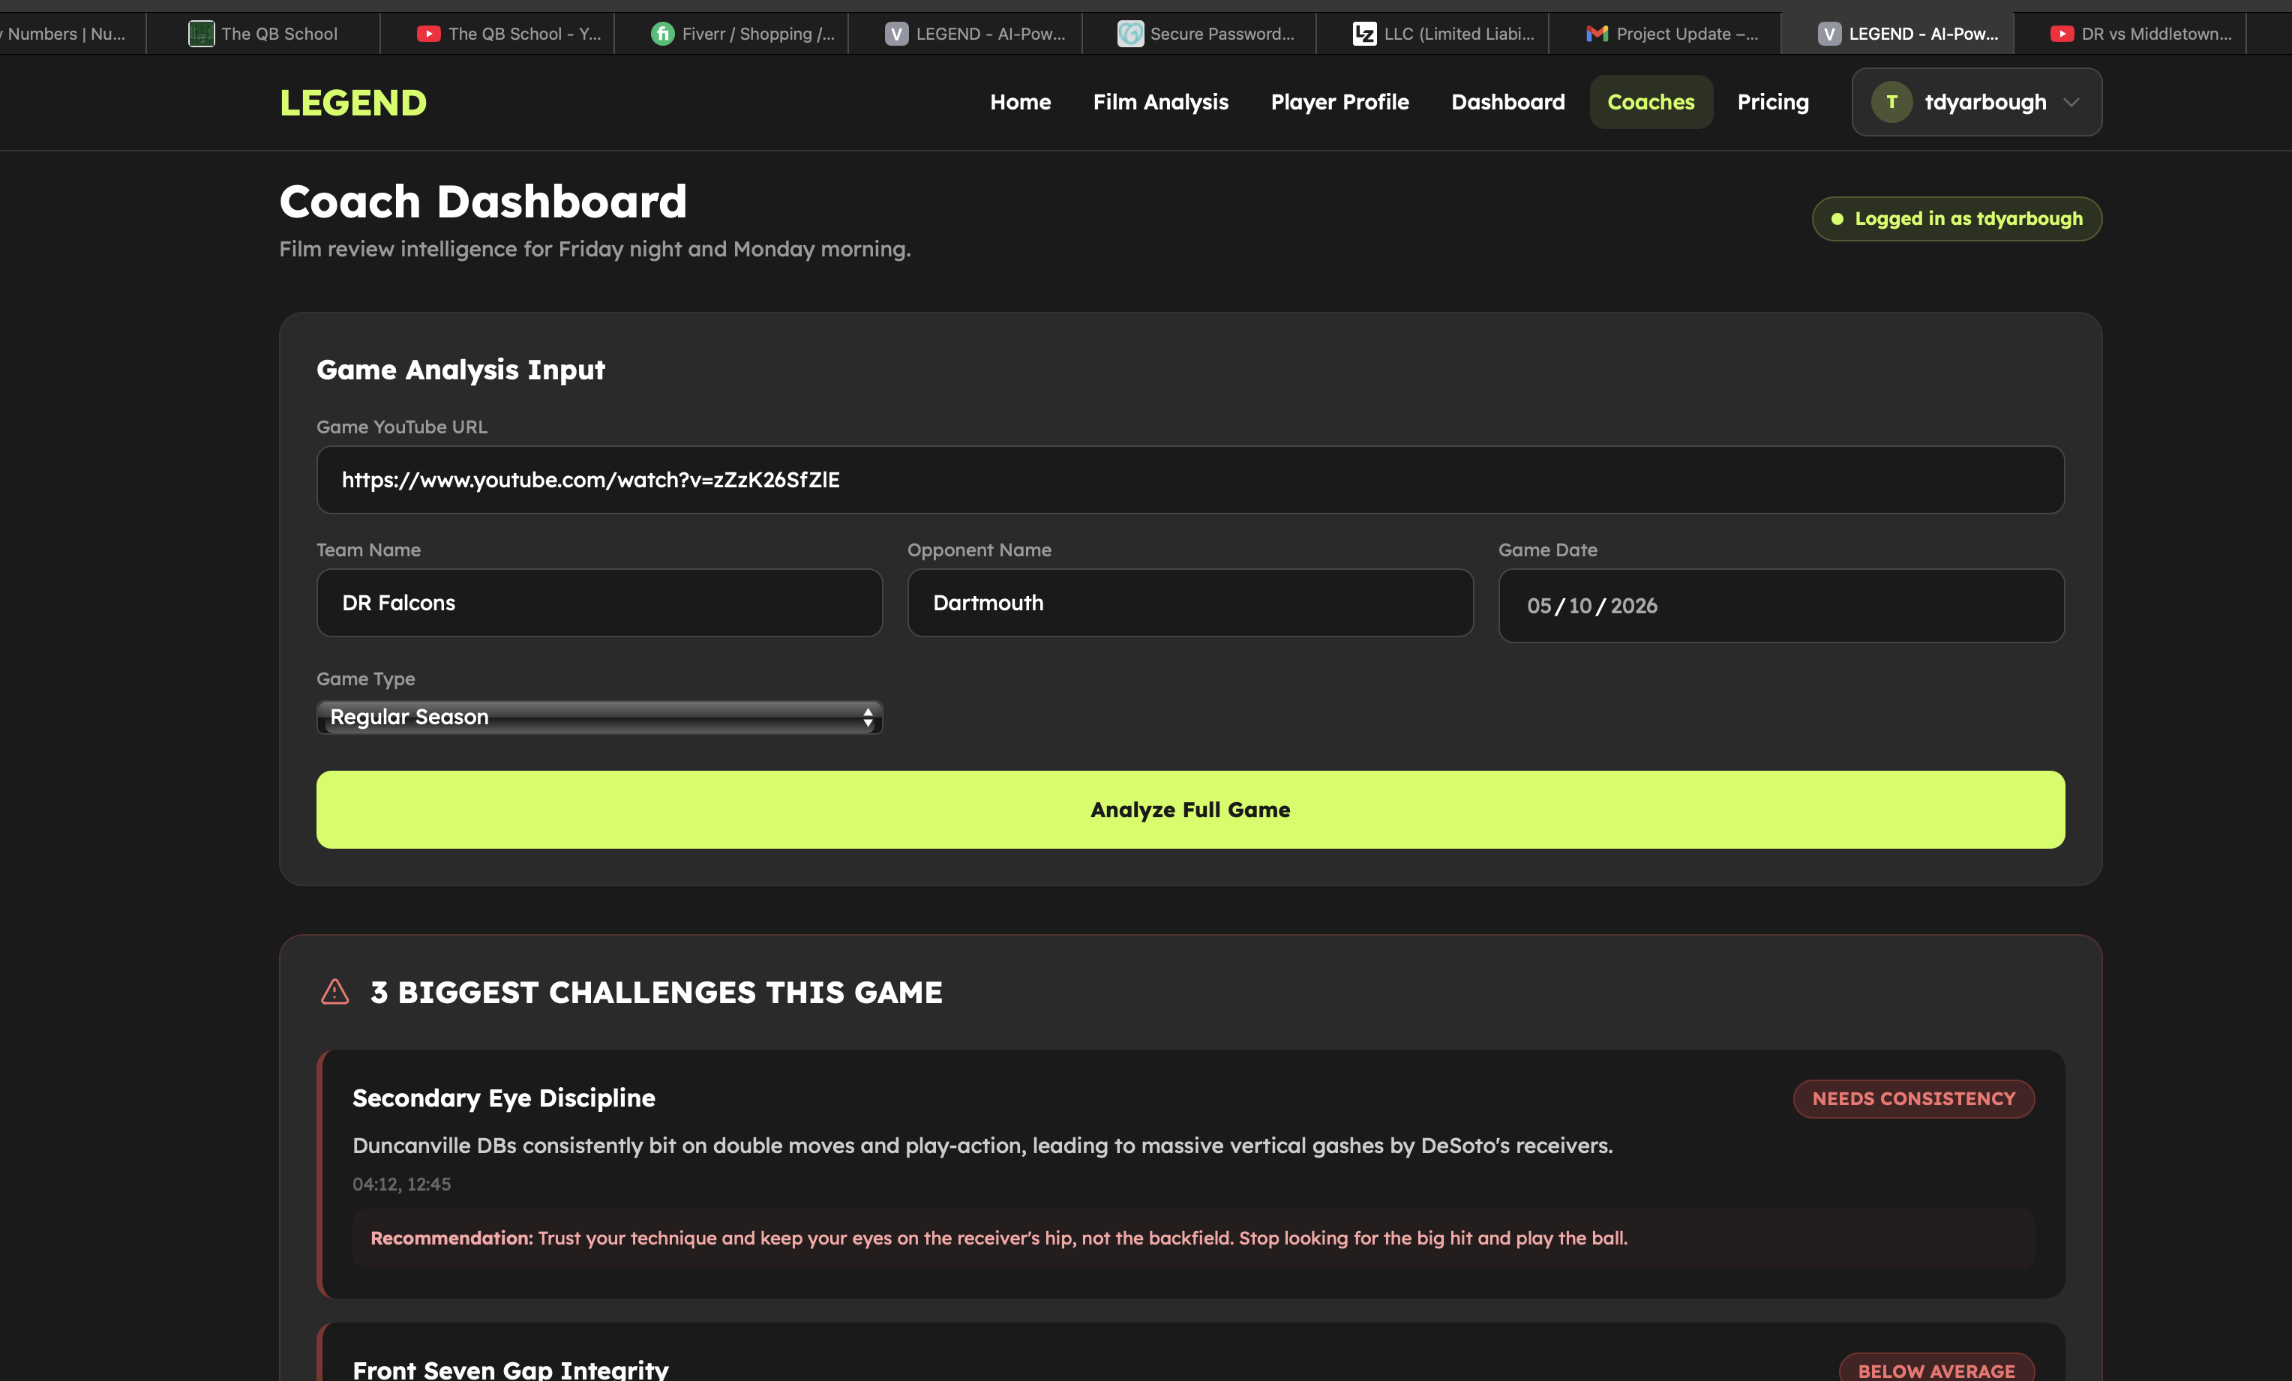
We need an additional field to tell AI what team is the DR Falcons to prevent misreads. Create a field called jersey color next to team name. It read correctly but I could see this getting messed up.
Who is Duncanville? AI is giving feedback for QB with eye discipline and then mentions DB which is defense.
Notes:
Feed back is inaccurate
Ai is giving feed back for offensive player not db

Slide 2
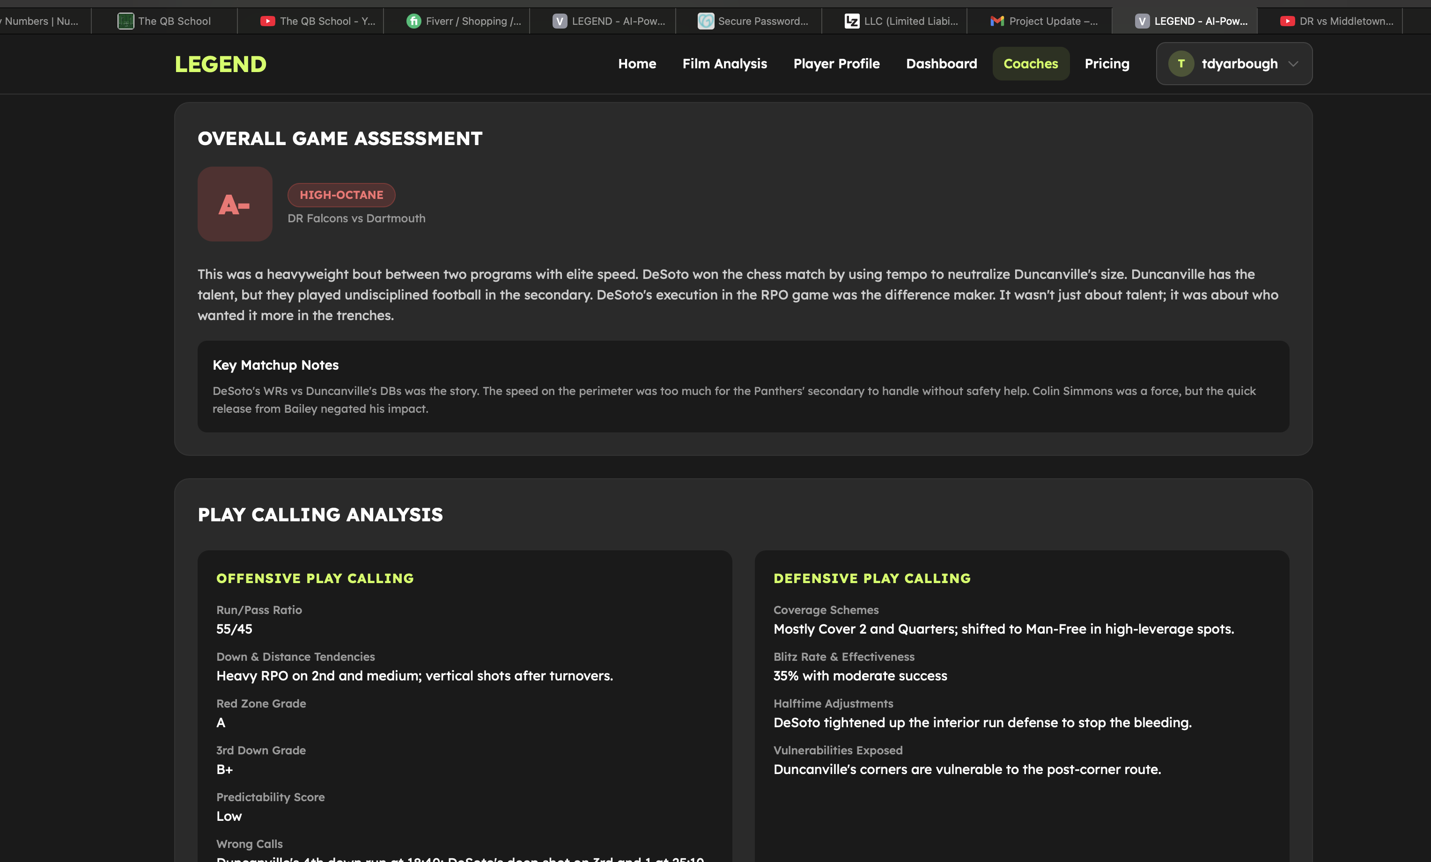
I would think an A score would be green? And a bad score would be red? Below text says Desoto – no clue who that is. This looks made up.
Again here – who is Desoto and Duncanville? Made up

Slide 3
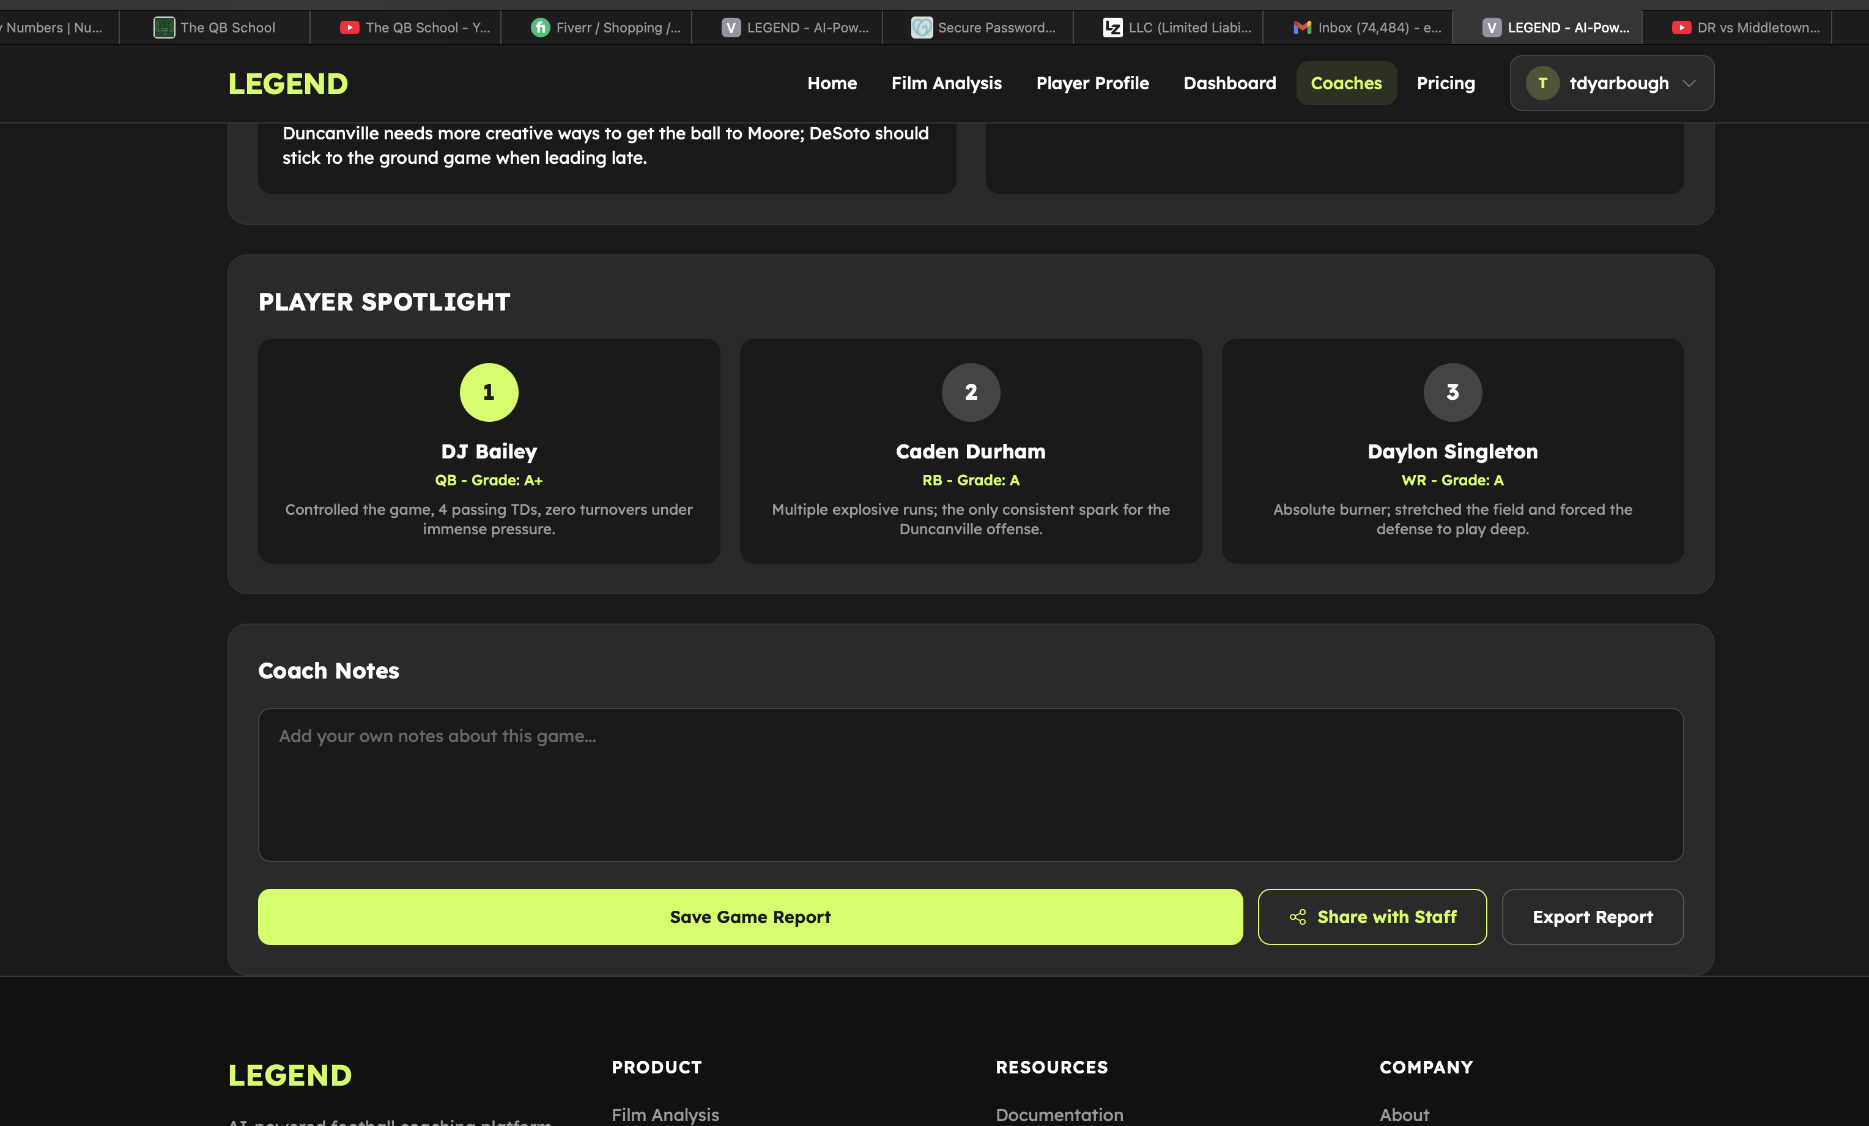
This here is all made up. Ideally we would have a place for a coach to upload a roster to help the AI identify players

Slide 4
Additional feedback:
When AI is running it says Coach Prime – we can’t say that. We can say Coach Legend.
We need a way for the player to save to player profile, and coaches should save to coaches profile. Right now when I toggle off analysis page the analysis disappears which is frustrating.

